Slide 1

Predicting Car Prices Using Data Science
A Machine Learning Project Transforming the Automotive Market
Presented By : Navdeep Kaur
URN : 2302617

Slide 2





The Challenge: Why Predict Car Prices?
Rapid Market Growth
India alone sells 3.4 million used vehicles annually
Pricing Uncertainty
Inconsistent valuations create confusion for buyers and sellers
Intermediary Issues
Traditional sales prone to manipulation and hidden costs
Data-Driven Solution
ML enables fair, transparent pricing decisions

Slide 3

Project Objective & Scope
Core Goals
Key Features Analysed
Build supervised ML model for price forecasting
Brand and model
Analyse multiple car attributes comprehensively
Manufacturing year
Generate feature-wise predictions and visual insights
Kilometres driven (mileage)
Deploy interactive web application
Fuel type and transmission
Engine specifications

Slide 4

Data Collection & Preprocessing
01
Data Collection
2000+ cars from premium brands: BMW, Tesla, Volkswagen, Acura
02
Feature Extraction
Manufacturing year, mileage, fuel type, owner status, seating capacity
03
Data Cleaning
Handled missing values, removed duplicates, encoded categorical Variables
04
Train-Test Split
Partitioned dataset for robust model validation and testing

Slide 5
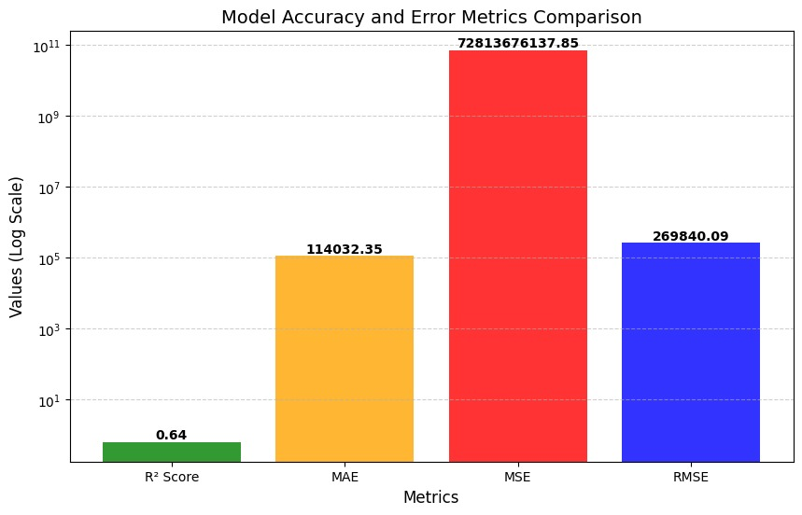
Modelling Approach: Algorithms Compared
Linear Regression
1
Baseline model establishing fundamental price-feature relationships
Model Performance Metrics:
R² Score :0.6424
MAE :114032.35 MSE :72813676137.85
RMSE : 269840.09
2
Evaluation Metrics: RMSE (Root Mean Square Error), R² Score, Cross-Validation

Slide 6
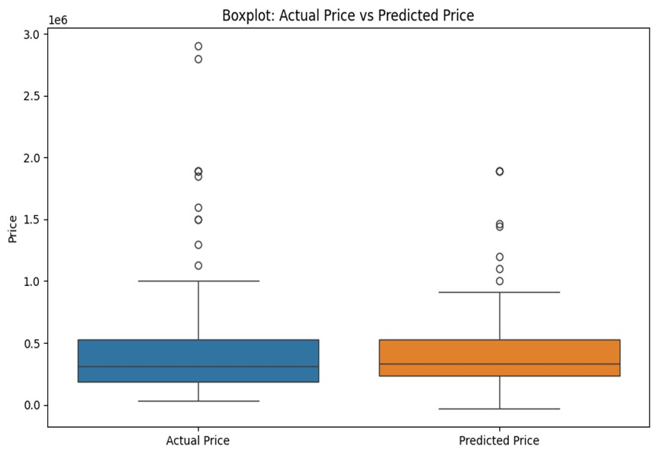



Visualising Results
Prediction Accuracy
Actual vs Predicted prices show close alignment along ideal
line
Feature Importance
Mileage, car age, and brand emerge as top price influencers
Interactive Exploration
Dynamic plots enable users to explore feature-price
relationships

Slide 7
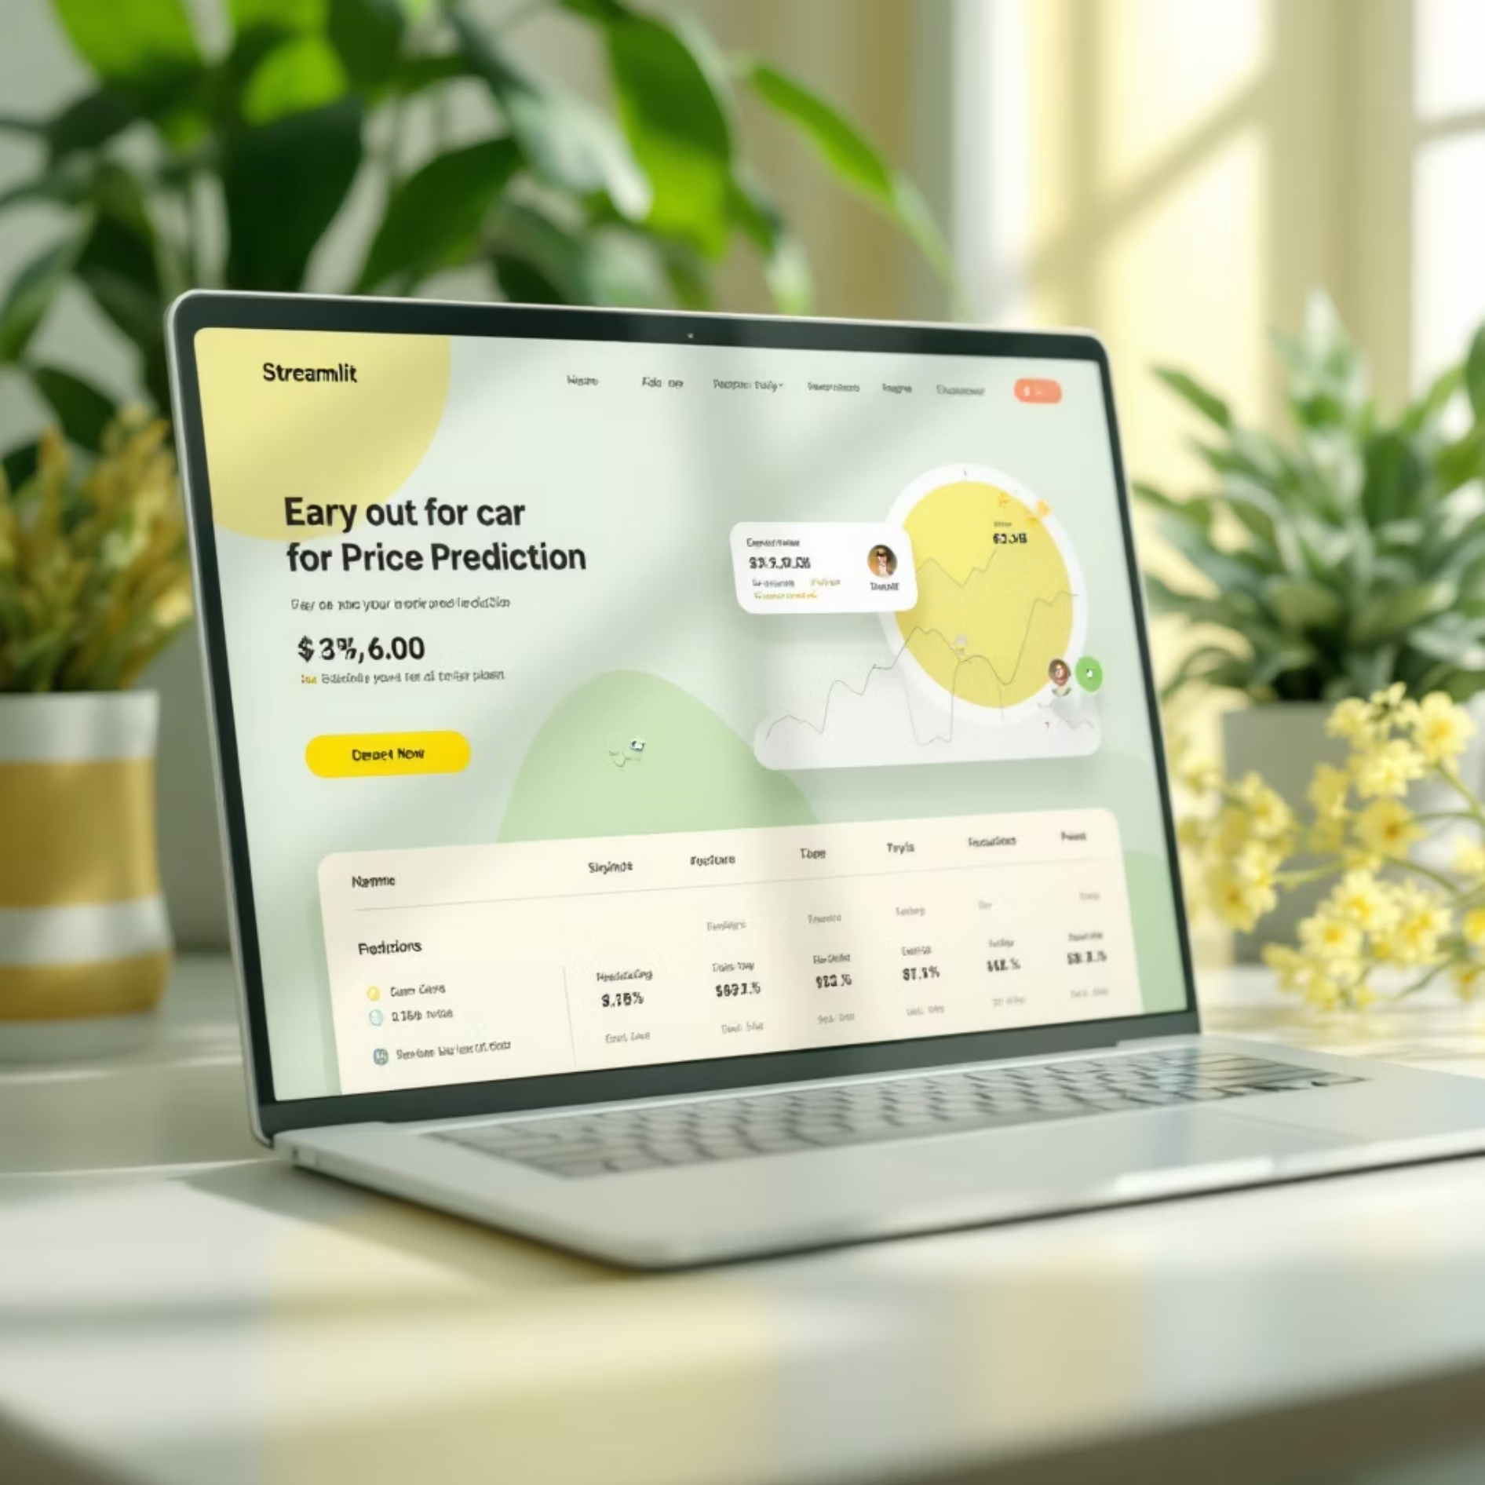
Deployment: Real-Time Price Prediction App
Application Features
User-Friendly Interface
Built with Python and Streamlit framework
Instant Predictions
Users input specs, receive immediate price estimates
Informed Decisions
Empowers both buyers and sellers with data insights
Integration Ready
Potential deployment to online marketplaces

Slide 8


Business Impact & Future Directions
Current Impact
Future Roadmap
Enhanced transparency and trust in transactions
Incorporate additional data sources and market trends
Optimised pricing strategies for dealers
Implement deep learning models for enhanced accuracy
Data-driven decision making for consumers
Expand to motorbikes, electric and hybrid vehicles

Slide 9


